Slide 1





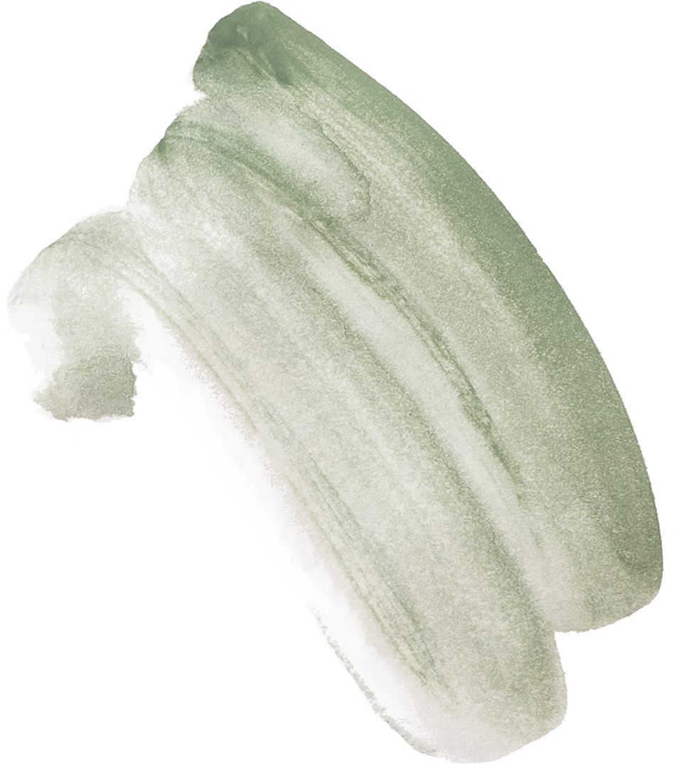




SEPHORA WEBSITE
ADVANCE STATISTICAL METHODS AND TESTING OF HYPOTHESIS
ANJALI CHAUHAN
3154
2022- 2023

Slide 2


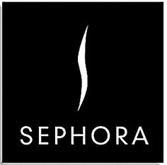
~ Sephora is a French multinational retailer of personal care and beauty products.
~ The company was founded in Limoges in 1969 and is currently based in Neuilly-sur-Seine, France.
~ We operate over 2,700 stores in 35 countries worldwide, with an expanding base of over 500 stores across the Americas, and a world-class e-commerce site. (https://www.sephora.com/)
~ Sephora offers beauty products including cosmetics, skincare, body, fragrance, nail color, beauty tools, body lotions, and haircare.
SEPHORA

Slide 3
Rows and Columns
Column Names
About Dataset
1499
16
Id
Brand
Category
Name
Rating
Number of Review
Love
Price
Value Price
Marketing Flags
Marketing Flag content
Detail
Online only
Exclusive
Limited Edition
Limited time offer

Slide 4
HYPOTHESIS
OBJECTIVES
Is there a significant difference between price and valued price on products on the Sephora website
Does the Number of reviews received on the product make a difference in rating
To verify if there is an association between online sales & exclusive sales on products by brand on Sephora website
To inspect whether limited edition products on Sephora makes a difference on sales of the product.
To authenticate whether the marketing flag used for marketing affects the brand name on the Sephora website

Slide 5
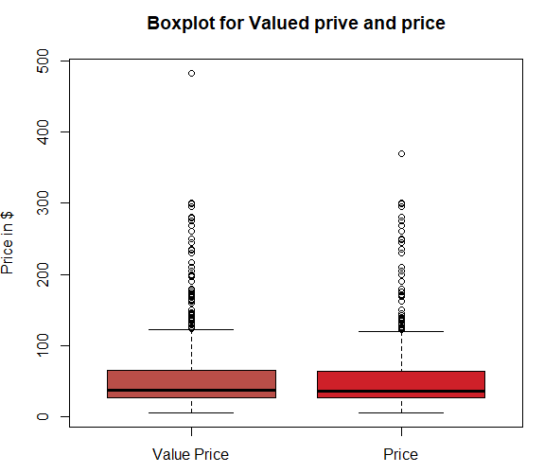
(1) Is there a significant difference between price and valued price on products on the Sephora website.
Wilcoxon test
H0: There is no significant difference between price and value_price
H1: There is a significant difference between price and value_price
data | test | p-value
Price | 1145639 | 0.3501
p-value is greater than 0.05 (0.3501> 0.05), Hence we accept H0.
This supports that there is a significant difference between price and value_price.
After applying Wilcoxon Text it proves that there is a difference between the price and valued price of products on the Sephora website.
The actual initial value price of the product varies from the price at which the product is sold on the website with seasonal offers and discounts offered.

Slide 6
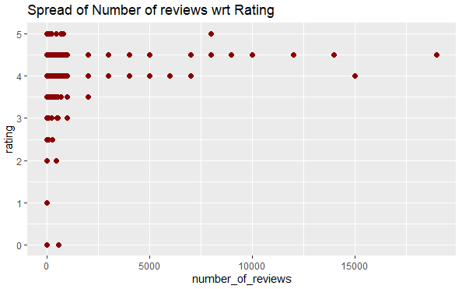
(2) Does the Number of reviews received on the product make a difference in rating?
Wilcoxon test
H0: Number of reviews does not make a difference on rating
H1: Number of reviews makes a difference on rating
data | test | p-value
(data$number_of_reviews, data$rating) | 0.72693 | 2.2e-16
p value is smaller than 0.05, Hence we reject H0.
This confirms that the number of reviews makes a difference
We concluded that the number of reviews received on the product makes a difference in rating.
The product with a high number of reviews and more ratings on them.

Slide 7
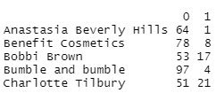
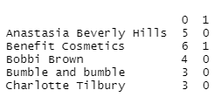
(3) To verify if there is an association between online sales & exclusive sales on products by brand on Sephora website?
Chi square test
H0: There is no association between online sales & exclusive sales
H1: There is an association between online sales & exclusive sales
data | x-squared | df | p-value
(data$online_only, data$exclusive) | 1.9886 | 1 | 0.1585
p-value is greater than 0.05(0.1585> 0.05), Hence we accept H0.
this conveys that, there is no association between online sales & exclusive sales
It is verified that there is no association between online sales & exclusive sales of products by brand on the Sephora website.
Online sales and exclusive sales only on the Sephora website are independent of each other and have no association between them.

Slide 8
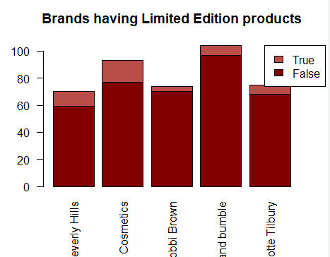
(4) To inspect whether Brands on Sephora release many Limited edition product for sale.
ANOVA test
#H0: Brand releases limited edition products on Sephora.
#H1: Brand releases less limited edition products on Sephora.
df= 53 sum sq= 6.78 mean sq= 1.12786
f-value= 1.65 p-value=0.00255
p-value = 0.00255
p-value is smaller than 0.05, Hence we reject H0.
This indicates that there is no significant difference in brand products having limited editions on Sephora.
Limited edition products are less launched by brands on Sephora.
The limited edition products are expensive compared to other products of the brand.

Slide 9
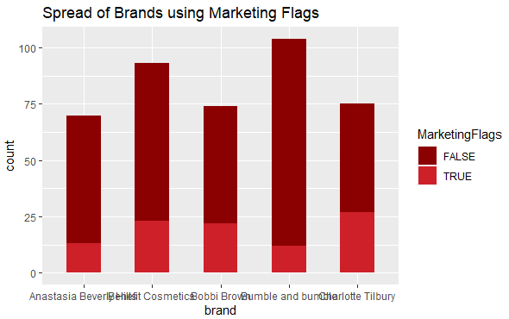
(5) To authenticate whether the marketing flag used for marketing affects the brand name on the Sephora website?
Chi square test
H0: There is no association between brand & marketing flags
H1: There is an association between brand & marketing flags
data | x-squared | df | p-value
(data$brand, data$MarketingFlags) | 513.34 | 53 | 2.2e-16
ONLINE
Exclusive
p value is smaller than 0.05, Hence we reject H0.
this implies that there is an association between brand & marketing flags.
The marketing flag used for marketing affects the brand name on the Sephora website.
The products get more exposure when marketing flags are used on them which makes a difference in sales of the product.

Slide 10
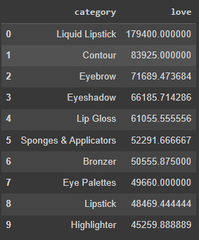
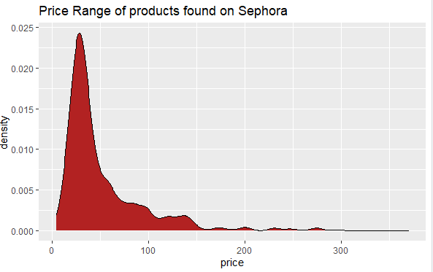
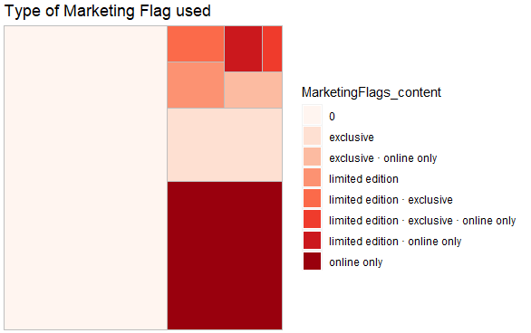
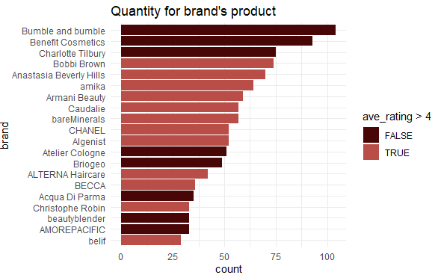
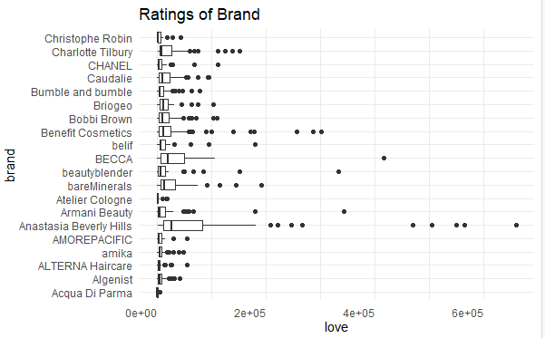

Slide 11
Thank you

